Slide 1
Automatic DBMS tuning

Slide 2
Two major tuning areas
Physical design(Indexes, materialized views)
Holistic parameters (knob settings - buffer size,etc.)

Slide 3
Holistic parameter tuning
Previous works
iTuned (Gaussian Process)
OtterTune (Gaussian Process)
CDBTune (DDPG)

Slide 4
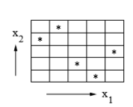
iTuned
Uses Latin Hypercube Sampling to get the initial points.(Adaptive sampling)
Gaussian Process with EIP
Efficiency is from
Selecting important parameters.
Parallel experiments
Early abort
Workload compression

Slide 5
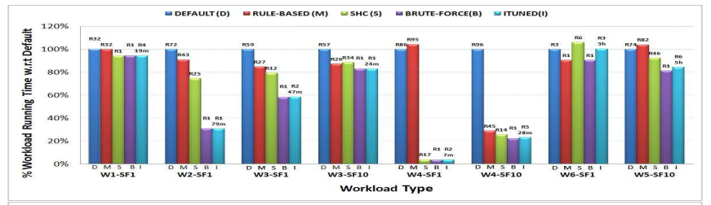

Slide 6
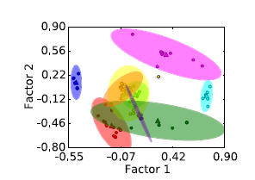
OtterTune
Uses a collection of previous experience in a repository
Gaussian Process with EIP, but already trained model
Efficiency
Maps a workload to a previous experience.
Pruning redundant metrics(Factor analysis and k-means) to adpat to any database.
Identifying important knobs. (Lasso)
Dependencies (Lasso)
Incremental knob selection

Slide 7
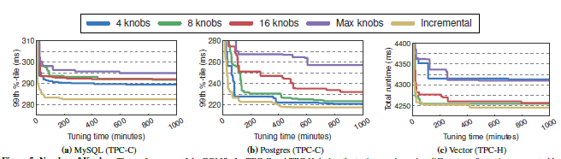

Slide 8
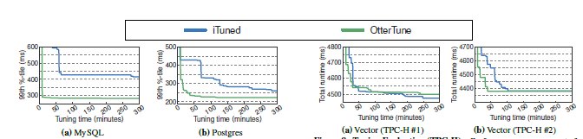
iTuned vs OtterTuned
Tuning time
iTuned 7hours, OtterTuned < 60 min

Slide 9
CDB Tune
Uses DDPG(Deep Deterministic Policy Gradient)
Advantages over OtterTune
OtterTune and other models can't get large high quality samples to learn.
High dimensional continuous space can't be optimized by GP Regression of OtterTune.
Knobs are in continuous space with unseen dependencies.
Ranking and feature extraction are already handled.

Slide 10
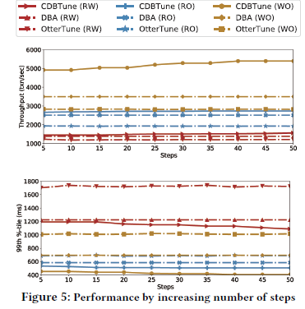
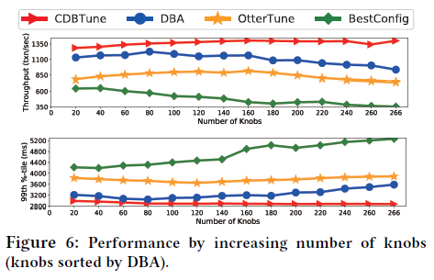

Slide 11
Standard test benchmarks
Sysbench
TPC
Wikipedia

